Slide 1
C1: Chapter 3 Equations and Inequalities
Dr J Frost (jfrost@tiffin.kingston.sch.uk)
Last modified: 18th September 2013

Slide 2
How many solutions for x and y?
For x
For y
?
2
?
x² = 4
∞
?
1
?
x = 3
∞
x + y = 9
?
∞
?
∞
x + y = 9
x – y = 1
?
?
1
1

Slide 3
By using graphical methods, solve the simultaneous equations:
x + y = 7
2x – y = -1
8
6
4
2
-2
-4
-6
Solution:
x = 2, y = 5
But why does finding the intersection of the lines give the solution?
The line for each equation represents all the points (x,y) for which the equation is satisfied.
Therefore, at the intersection(s), this gives the points for which both equations are satisfied.
x + y = 7
?
-10 -8 -6 -4 -2 2 4 6 8 10
2x – y = -1
Click to sketch
Notes:
Get students to sketch axes and tables in their books.

Slide 4
Solutions by sketching
By sketching the simultaneous equations on a single graph, determining how many solutions there are. (You need not determine what the solutions are)
y = x² – x – 2
y = 2x
y = -x²
y = 2 – x
Num solutions: 2
?
Num solutions: 0
?

Slide 5
GCSE recap
Solve the following simultaneous equations by:
(a) elimination (b) substitution
2x – y = 1
4x + 2y = -30
x = -3 ½ , y = -8
?
?
Solve the following simultaneous equations by substitution.
2y = 2x – 3
3y = x – 1
x = 1 ¾ , y = ¼
?
?
Notes:
Probably skip the latter question to get to quadratic simultaneous equations as soon as possible.

Slide 6
Solving more difficult simultaneous equations
Previously, both equations were linear equations.
At A Level, you may have one quadratic equation, and one linear.
The strategy is just to substitute the linear equation into the quadratic one.
x + 2y = 3
x² + 3xy = 10
3x – 2y = 1
x² + y² = 25
x = 4, y = -1/2, and
x = 5, y = -1
?
x = 3, y = 4, and
x = -33/13, y = -56/13
?

Slide 7
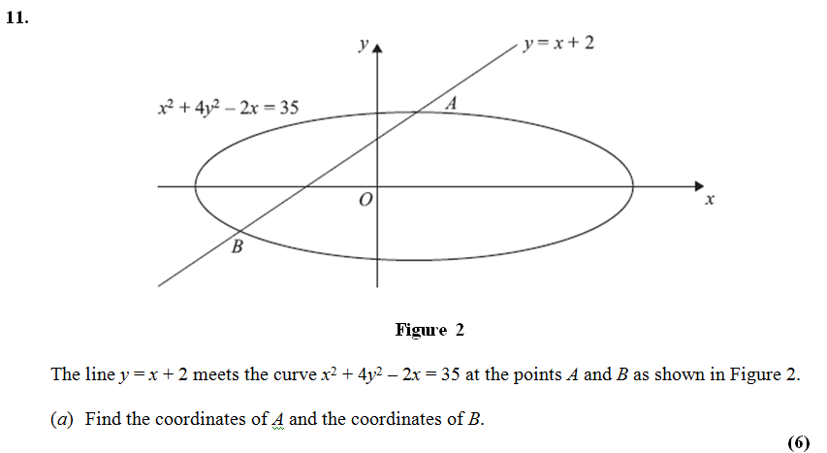
Exam Question
June 2013 (retracted paper)
x = -19/5, y = -9/5, and
x = 1, y = 3
?

Slide 8
Exercises
Exercise 3C
All questions (your homework will be to finish the exercise)

Slide 9
Proving that lines do not intersect
?
We could double the equation for C and then equate the RHSs:
2x(5 – x) = 5x + 4
2x² – 5x + 4 = 0
The discriminant is 25 – (4 x 2 x 4) = -7
This is < 0, so no solutions.

Slide 10
Deal or No Deal?
We can manipulate inequalities in various ways, but which of these are allowed and not allowed?
x > 3
Can we add or subtract to both sides?
x - 1 > 2
✓
Click to Deal
✗
Click to No Deal

Slide 11
Deal or No Deal?
We can manipulate inequalities in various ways, but which of these are allowed and not allowed?
2x > 6
Can we divide both sides by a positive number?
x > 3
✓
Click to Deal
✗
Click to No Deal

Slide 12
Deal or No Deal?
We can manipulate inequalities in various ways, but which of these are allowed and not allowed?
x < 1
Can we multiply both sides by a positive number?
4x < 4
✓
Click to Deal
✗
Click to No Deal

Slide 13
Deal or No Deal?
We can manipulate inequalities in various ways, but which of these are allowed and not allowed?
x < 1
Can we multiply both sides by a negative number?
-x < -1
✗
Click to Deal
✓
Click to No Deal

Slide 14
‘Flipping’ the inequality
If we multiply or divide both sides of the inequality by a negative number, the inequality ‘flips’!
OMG magic!
-2
-4
2
<
4
× (-1)
Click to Start
Bromanimation
× (-1)

Slide 15


Deal or No Deal?
We can manipulate inequalities in various ways, but which of these are allowed and not allowed?
$$\frac{1}{x}<2$$
Can we multiply both sides by a variable?
$$1<2x$$
✗
Click to Deal
✓
Click to No Deal
The problem is, we don’t know if the variable has a positive or negative value, so negative solutions would flip it and positive ones wouldn’t. But you won’t have to solve questions like this unless you’re doing FP2!

Slide 16
Linear Inequalities
Solve the following inequalities.
$$2x−5<7$$
?
$$x<6$$
$$5x+9≥x+20$$
?
$$x≥2.75$$
?
$$12−3x<27$$
$$x>−5$$
?
$$3\left(x−5\right)>5−2(2x−8)$$
$$x>7.2$$

Slide 17
Inequalities on a Number Line
x > 3
This is known as a ‘strict’ inequality.
x < -1
Means: x is (strictly) greater than 3.
?
Means: x is (strictly) less than -1.
?
0 1 2 3 4 5
-3 -2 -1 0 1 2
?
?
x ≥ 4
x ≤ 5
Means: x is greater than or equal to 4.
?
Means: x is less than or equal to 4.
?
2 3 4 5 6 7
2 3 4 5 6 7
?
?

Slide 18
Inequalities on a Number Line
It’s absolutely crucial that you distinguish between the words ‘and’ and ‘or’ when constraining the values of a variable.
AND
How would we express
“x is greater than or equal to 2, and less than 4”?
OR
How would we express
“x is less than -1, or greater than 3”?
x ≥ 2 and x < 4
x < -1 or x > 4
?
?
x ≥ 2, x < 4
?
This is the only way you would write this – you must use the word ‘or’.
2 ≤ x < 4
?
This last one emphasises the fact that x is between 2 and 4.

Slide 19
I will shoot you if I see any of these…
$$4>x<8$$
$$4<x>7$$

Slide 20
Inequalities on a Number Line
$$2≤x<4$$
$$x<−1 or x>4$$
0 1 2 3 4 5
-1 0 1 2 3 4
?
?

Slide 21
Inequalities on a Number Line
To illustrate the difference, what happens when we switch them?
or
and
x ≥ 2 and x < 4
x < -1 or x > 4
0 1 2 3 4 5
-1 0 1 2 3 4
?
?

Slide 22
Combining Inequalities
Find the set of values for which 12 + 4x > x² AND 5x – 3 > 2
12 + 4x > x²
-2 < x < 6
5x – 3 > 2
x > 1
-2 -1 0 1 2 3 4 5 6
$$−2<x<6$$
?
$$x>1$$
?
Combined
?
$$1<x<6$$

Slide 23
Combining Inequalities
2
5
$$x<2 or x>5$$
4
$$x>4$$
Combined
?
$$x>5$$
2
5
$$2<x<5$$
4
$$x<4$$
Combined
?
$$2<x<4$$

Slide 24
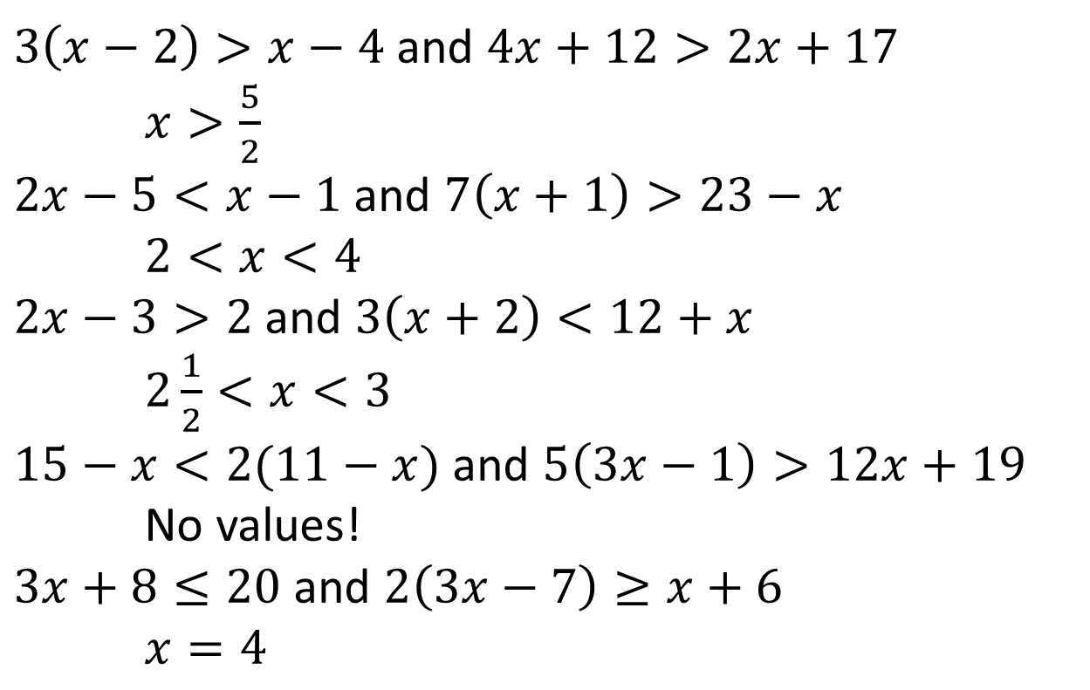
Exercise 3D
Find the set of values of $x$ for which:
$3\left(x−2\right)>x−4$ and $4x+12>2x+17$
$x>\frac{5}{2}$
$2x−5<x−1$ and $7\left(x+1\right)>23−x$
$2<x<4$
$2x−3>2$ and $3\left(x+2\right)<12+x$
$2\frac{1}{2}<x<3$
$15−x<2(11−x)$ and $5\left(3x−1\right)>12x+19$
No values!
$3x+8≤20$ and $2\left(3x−7\right)≥x+6$
$x=4$
3a
?
3b
?
3c
?
3d
?
3e
?

Slide 25
Quadratic Inequalities
Solve $x^{2}−4x−5<0$
$$−1<x<5$$
?
To solve quadratic inequalities:
Put in form $…>0$ or $…<0$
Factorise the quadratic.
Sketch
Use sketch.

Slide 26
Quadratic Inequalities
Solve $x^{2}−4x−5>0$
?
$$x<−1 or x>5$$
Bro Tip: Remember that you solution will be in one of these two forms:
$a<x<b$
$x<a$ or $x>b$

