Slide 1
C4 Chapters 6/7: Trigonometry
Dr J Frost (jfrost@tiffin.kingston.sch.uk)
www.drfrostmaths.com
Last modified: 20th September 2015

Slide 2
Recap
These are all the things you’re expected to know from C2:
?
?
$$\tan{x}=\frac{\sin{x}}{\cos{x}}$$
$$\sin^{2}{x}+\cos^{2}{x}=1$$
1
$$\sin\left(x\right)=\sin\left(π−x\right)$$
$$\cos\left(x\right)=\cos\left(2π−x\right)$$
$sin/cos$ repeat every $2π$
$tan$ repeats every $π$
$$\sin\left(x\right)=\cos\left(\frac{π}{2}−x\right)$$
A
2
?
B
?
3
?
4
?
5
?
Bro Tip: Many student’s lack of knowledge of this one cost them dearly in June 2013’s C3 exam.

Slide 3
A new member of the trig family…
$$\cos\left(x\right)$$
Original and best. Like the ‘Classic Cola’ of trig functions.
$$\cos^{2}\left(x\right)={\left(\cos{x}\right)}^{2}$$
The latter form is particularly useful for differentiation (see Chp8)
$$\cos^{−1}\left(x\right) or arccos⁡(x)$$
Be careful: the -1 here doesn’t mean a power of -1 UNLIKE $\cos^{2}{x}$ above. This is an unfortunate historical accident.
$$\sec\left(x\right)=\frac{1}{\cos\left(x\right)}$$
We have a way of representing the reciprocal of the trig functions.

Slide 4
Reciprocal Trigonometric Functions
!
$$\sec\left(x\right)=\frac{1}{\cos\left(x\right)}$$
Short for “secant”
Pronounced “sehk” in shortened form or “sea-Kant” in full.
$$\operatorname{cosec}\left(x\right)=\frac{1}{\sin\left(x\right)}$$
Short for “cosecant”
Written as $\csc{x}$ everywhere except in A Level textbooks/exams.
$$\cot\left(x\right)=\frac{1}{\tan\left(x\right)} or \frac{\cos\left(x\right)}{\sin\left(x\right)}$$
Short for “cotangent”
In shortened form, rhymes with “pot”.
Bro Tip: To remember these, look at the 3rd letter: $sec$’s 3rd is ‘c’ so it’s 1 over cos.

Slide 5
Where do they come from?
You might have always wondered why “co-sine” is so named. And isn’t a “secant” a line or something, just like a tangent is? And why of the reciprocal functions, do “cot” and “cosec” have the “co” but “sec” doesn’t? Let’s have some help from the Greeks…
Imagine a sector
sin/tan/sec gives the ratio of each of the lines with the radius of the sector.
(If the radius is 1, we actually get the length of the lines)
$tangent$ comes from the Latin “tangere” meaning “to touch”.
A secant is a line which cuts a circle (unlike a tangent which touches). It comes from the Latin “secare” meaning “to cut”
$$secant$$
$$tangent$$
$$sine$$
$$θ$$
$sine$ comes from the Latin “sinus” meaning bend. It is a translation from a Sanskrit word meaning ‘bowstring’. You can sort of see how the line could be half a bow.

Slide 6
Let’s introduce a bit of $co$…
1: The ‘complimentary angle’ in a right-angled triangle is the other non-right angle.
Click for Bromanimation
$$α$$
$$secant$$
$$α$$
$$tangent$$
$$sine$$
$$θ$$
$$cosecant$$
3: …then the cosine/cosecant/cotangent are the sine, secant and tangent respectively (i.e. again the ratio with the sector radius).
“cosine” is short for the Latin “complimenti sinus” and so on.
$$α$$
co$sine$
2: Now suppose we repeated this diagram using the complementary angle…
$$cotangent$$

Slide 7
Sketches
If you did the L6 Summer Programme, you would have learnt a technique for sketching reciprocal graphs: i.e. we draw the original graph, then just reciprocate each of the $y$-values.
It touches here because the reciprocal of 1 is 1.
$$y$$
$$y=\operatorname{cosec}{x}$$
$cosec$ isn’t defined for multiples of $π$ because we can’t divide by 0.
Click to Brosketch $y=cosec x$
$$1$$
$$y=\sin{x}$$
$$x$$
$$\frac{1}{2}π$$
$$π$$
$$\frac{3}{2}π$$
$$2π$$
$$−1$$
Recall that reciprocating preserves sign. When we divide by a small positive number, we get a very large positive number.

Slide 8
Sketches
$$y$$
$$y=\sec{x}$$
Click to Brosketch $y=sec x$
$$1$$
$$y=\cos{x}$$
$$x$$
$$\frac{1}{2}π$$
$$π$$
$$\frac{3}{2}π$$
$$2π$$
$$−1$$

Slide 9
Sketches
$$y$$
Click to Brosketch $y=cot x$
$$y=\tan{x}$$
$$y=\cot{x}$$
$$x$$
$$\frac{1}{2}π$$
$$π$$
$$\frac{3}{2}π$$
$$2π$$

Slide 10
Calculations
You have a calculator in A Level exams, but won’t however in STEP, etc. It’s good however to know how to calculate certain values yourself if needed.
See my C2 Trig slides to see how to memorise certain angles.
?
$$\cot{\frac{π}{4}}=\frac{1}{\tan{\frac{π}{4}}}=\frac{1}{1}=1 \\ \sec{\frac{π}{4}=\frac{1}{\cos{\frac{π}{4}}}=\frac{1}{\frac{1}{\sqrt{2}}}=\sqrt{2}}$$
$$\operatorname{cosec}{\frac{π}{3}}=\frac{1}{\sin{\frac{π}{3}}}=\frac{2}{\sqrt{3}}$$
$$\cot{\frac{π}{6}}=\sqrt{3}$$
$$\operatorname{cosec}{\frac{5π}{6}}=\operatorname{cosec}{\frac{π}{6}}=2$$
$$\cot{\frac{π}{3}}=\sqrt{3}$$
$$\sec{\frac{π}{6}}=\frac{2}{\sqrt{3}}$$
$$\operatorname{cosec}{\frac{π}{2}}=1$$
$$\sec{\frac{5π}{3}}=sec\frac{π}{3}=2$$
?
?
?
?
?
?
?
?

Slide 11
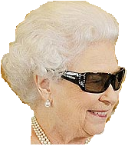
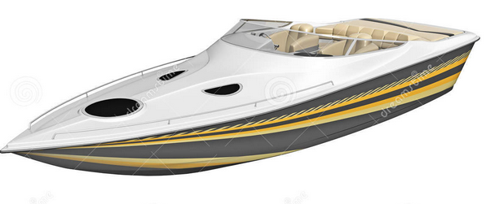
New Identities
From C2 you knew:
$$\sin^{2}{x}+\cos^{2}{x}=1$$
There are just two new identities you need to know:
Bro Tip: I used to misremember this as $1+\sec^{2}{x}=\tan^{2}{x}$.
Then I imagined the Queen coming back from holiday, saying “One is tanned”, i.e. the 1 goes with the $\tan^{2}{x}.$
Dividing by $\cos^{2}{x}$:
$$1+\tan^{2}{x}=\sec^{2}{x}$$
?
$$1+\cot^{2}{x}={cosec}^{2}{x}$$
Dividing by $\sin^{2}{x}$:
?
Bro Tip: I remember this one by starting with the above, and slapping ‘co’ on front of each trig function.

Slide 12
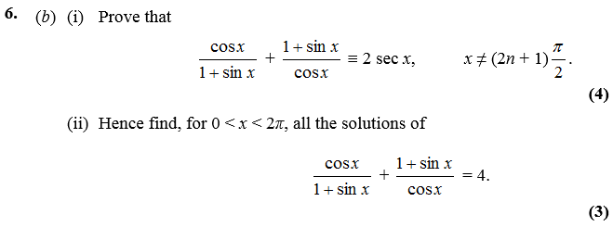
Proof-ey Questions
Edexcel C3 Jan 2008
Bro Tips: For ‘proof’ questions, usually the best strategy is to:
a) Express most things in terms of sin and cos before simplifying. b) Expressing one side as a single fraction.
v
?
$$\frac{\cos^{2}{x}+{\left(1+\sin{x}\right)}^{2}}{\cos{x}\left(1+\sin{x}\right)} \\ =\frac{\cos^{2}{x}+1+2\sin{x}+\sin^{2}{x}}{\cos{x}\left(1+\sin{x}\right)} \\ =\frac{2\left(1+\sin{x}\right)}{\cos{x}\left(1+\sin{x}\right)} \\ =\frac{2}{\cos{x}}=2\sec{x}$$
Edexcel C3 Jan 2007
?
Using identities:
$$LHS=\left(1+\tan^{2}{x}\right)−\left(1+\cot^{2}{x}\right) \\ =1+\tan^{2}{x}−1−\cot^{2}{x} \\ =\tan^{2}{x}−\cot^{2}{x}$$

Slide 13
Test Your Understanding
$$\sec{x}−\cos{x}≡\sin{x}\tan{x} \\ LHS=\frac{1}{\cos{x}}−\cos{x} \\ =\frac{1−\cos^{2}{x}}{\cos{x}} \\ =\frac{\sin^{2}{x}}{\cos{x}} \\ =\sin{x}\tan{x}$$
2
$$\left(1+\cos{x}\right)\left(\operatorname{cosec}{x}−\cot{x}\right)≡\sin{x} \\ LHS=csc{x}−\cot{x}+\cos{x}\csc{x}−\cos{x}\cot{x} \\ =\frac{1}{\sin{x}}−\cot{x}+\cot{x}−\frac{\cos^{2}{x}}{\sin{x}} \\ =\frac{1−\cos^{2}{x}}{\sin{x}}=\frac{\sin^{2}{x}}{\sin{x}}=\sin{x}$$
1
?
?
Bro Tips: For ‘proof’ questions, usually the best strategy is to:
a) Express most things in terms of sin and cos before simplifying. b) Expressing one side as a single fraction.
Example in textbook
Prove that ${cosec}^{4}{θ}−\cot^{4}{θ}=\frac{1+\cos^{2}{θ}}{1−\cos^{2}{x}}$
$$LHS= \left({cosec}^{2}{θ}{+\cot^{2}{θ}}\right)\left({cosec}^{2}{θ}−\cot^{2}{θ}\right) \\ ={cosec}^{2}{θ}{+\cot^{2}{θ}} \\ =\frac{1}{\sin^{2}{θ}}+\frac{\cos^{2}{θ}}{\sin^{2}{θ}} \\ =\frac{1+\cos^{2}{θ}}{1−\cos^{2}{x}}=RHS$$
?
Bro Hint: Difference of two squares.

Slide 14
Exercises
Exercise 6D
1
Simplify each expression:
$$1+\tan^{2}{\frac{1}{2}θ}=\sec^{2}{\frac{1}{2}θ} \\ \tan^{2}{θ}\left({cosec}^{2}{θ}−1\right)=1 \\ \frac{\tan{θ}\sec{θ}}{1+\tan^{2}{θ}}=\sin{θ} \\ \sec^{4}{θ}−2\sec^{2}{θ}\tan^{2}{θ}+\tan^{4}{θ}$$ $={\left(\sec^{2}{θ}−\tan^{2}{θ}\right)}^{2}=1^{2}=1$
Prove the following identities:
$$\sec^{4}{θ}−\tan^{4}{θ}≡\sec^{2}{θ}+\tan^{2}{θ}$$
$$LHS=\left(\sec^{2}{θ+\tan^{2}{θ}}\right)\left(\sec^{2}{θ−\tan^{2}{θ}}\right) \\ =\sec^{2}{θ+\tan^{2}{θ}}$$
$$\sec^{2}{A}\left(\cot^{2}{A}−\cos^{2}{A}\right)≡\cot^{2}{A}$$
$$LHS=\frac{1}{\cos^{2}{A}}\left(\frac{\cos^{2}{A}}{\sin^{2}{A}}−\cos^{2}{A}\right) \\ =cosec^{2}A−1=\cot^{2}A$$
$$\frac{1−\tan^{2}{A}}{1+\tan^{2}{A}}≡1−2\sin^{2}{A}$$
$$\operatorname{cosec}{A}\sec^{2}{A}≡\operatorname{cosec}{A}+\tan{A}\sec{A}$$
a
?
c
?
g
?
j
?
6
a
?
b
?
e
d

Slide 15
Solve-y Questions
Edexcel C3 June 2013 (R)
Bro Tip: This is just like in C2 if you had say a mixture of $\sin{θ},\sin^{2}{θ},\cos^{2}{θ}$: you’d change the $\cos^{2}{θ}$ to $1−\sin^{2}{θ}$ in order to get a quadratic in terms of $sin$.
$$3\sec^{2}{θ}+3\sec{θ}=2\left(\sec^{2}{θ}−1\right) \\ \sec^{2}{θ}+3\sec{θ}+2=0 →\left(\sec{θ}+2\right)\left(\sec{θ}+1\right)=0 \\ \frac{1}{\cos{θ}}=−2 → \cos{θ}=−\frac{1}{2} → θ=\frac{2π}{3},\frac{4π}{3} \\ \frac{1}{\cos{θ}}=−1 → \cos{θ}=−1 → θ=π$$
?
Q
Solve, for $0≤x<2π$, the equation
$$2cosec^{2}x+\cot{x}=5$$
giving your solutions to 3sf.
$$2\left(1+\cot^{2}{x}\right)+\cot{x}−5=0 \\ 2+2\cot^{2}{x}+\cot{x}−5=0 \\ 2\cot^{2}{x}+\cot{x}−3=0 \\ \left(2\cot{x}+3\right)\left(\cot{x}−1\right)=0 \\ \cot{x}=−\frac{3}{2} or \cot{x}=1 \\ \tan{x}=−\frac{2}{3} or \tan{x}=1 \\ x=2.55, 5.70, 0.785, 3.93$$
?

Slide 16
Test Your Understanding
Solve in the range $0≤x<360°$ the equation:
$$\cot^{2}{2x}−4\operatorname{cosec}{2x}+5=0$$
$$0≤2x<720°$$
$${\left(cosec \left(2x\right) −2\right)}^{2}=0 \\ cosec \left(2x\right)=2 \\ \sin\left(2x\right)=\frac{1}{2} \\ 2x=30°, 150°, 390°, 510° \\ x=15°,75°,195°, 255°$$
?

Slide 17
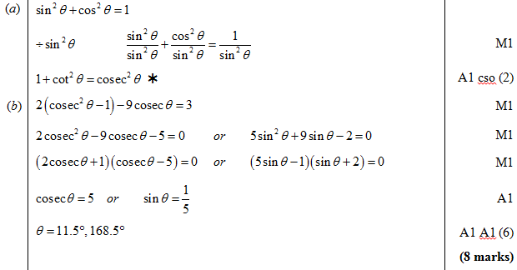
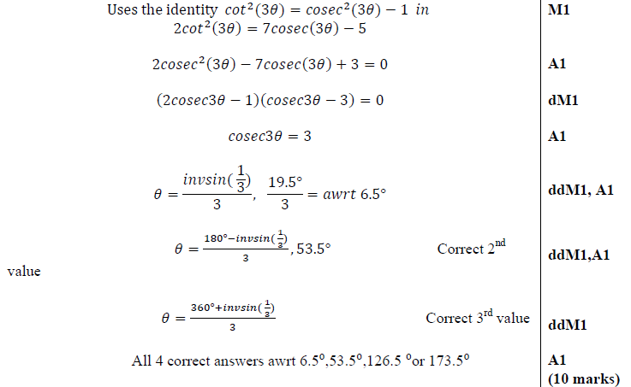
Exercises
8
Solve the following equations in the given intervals:
$$\sec^{2}{θ}=3\tan{θ} 0≤θ≤360°$$
$$20.9°, 69.1°, 201°, 249°$$
$${cosec}^{2}{θ}+1=3\cot{θ} −180≤θ≤180$$
$$−153°, −135°, 26.6°, 45° \\ 3\sec{\frac{1}{2}θ}=2\tan^{2}{\frac{1}{2}θ} 0≤θ≤360$$
$$120° \\ \tan^{2}{2θ}=\sec{2θ}−1 0≤θ≤180$$
$$0°, 180°$$
a
?
c
?
e
?
?
g
?
?
Edexcel C3 June 2008
?
Edexcel C3 Jan 2012

Slide 18
One final type of question…
Given that $\tan{θ}=\frac{5}{12}$, and that $θ$ is acute, determine $\sec{θ}$ and $\sin{θ}$
Method 1: Using identities
Method 2: Forming triangle
?
?
$$sec θ{=±\sqrt{\tan^{2}{θ}+1}} \\ =±\sqrt{\frac{169}{144}}=±\frac{13}{12}$$
The negative solution would occur if $θ$ was obtuse.
$$\cos{θ}=\frac{12}{13} \\ \sin{θ=\tan{θ}\cos{θ}} \\ =\frac{5}{12}×\frac{12}{13}=\frac{5}{13}$$
We could have got that equation from this triangle:
The 13 we obtain by Pythagoras. Then $\sec{θ}$ and $\cos{θ}$ can now be found trivially.
$$13$$
$$5$$
$$θ$$
$$12$$
Bro Exam Tip: You won’t get questions like this per se in the exam (as obviously you could use your calculator!). But it’s useful for STEP, etc.

Slide 19
Inverse Trig Functions
You need to know how to sketch $y=\arcsin{x}, y=\arccos{x}$, $y=\arctan{x}$.
(Yes, you could be asked in an exam!)
$$y$$
We have to restrict the domain of $\sin{x}$ to $−\frac{π}{2}≤x<\frac{π}{2}$ before we can find the inverse. Why?
Because only one-to-one functions have an inverse. By restricting the domain it is now one-to-one.
$$\frac{π}{2}$$
Click to Brosketch $y=arcsin x$
?
$$1$$
$$y=arcsin x$$
$$x$$
$$−\frac{π}{2}$$
$$−1$$
$$1$$
$$\frac{π}{2}$$
$$y=\sin{x}$$
$$−1$$
$$−\frac{π}{2}$$

Slide 20
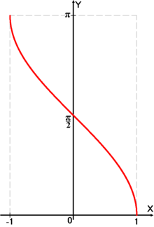
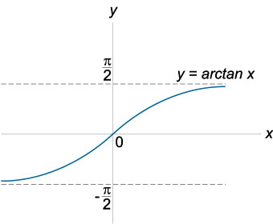
Inverse Trig Functions
$$y=\arccos{x}$$
$$y=\arcsin{x}$$
?
?
Note that this graph has asymptotes.

Slide 21
One Final Problem…
Edexcel C3 Jan 2007
?
Fewer than 10% of candidates got this part right.
$$y=\arccos{x} \\ x=\cos{y}=sin\left(\frac{π}{2}−y\right) \\ \arcsin{x=\frac{π}{2}−y}$$
$$\arccos{x+\arcsin{x}} \\ =y+\frac{π}{2}−y=\frac{π}{2}$$

Slide 22
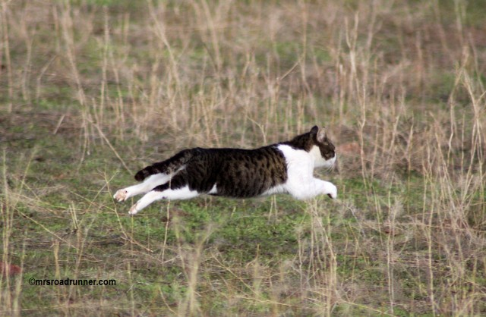
Onwards to Chapter 7...

Slide 23
Addition Formulae
Addition Formulae allow us to deal with a sum or difference of angles.
$$\sin\left(A+B\right)=\sin{A}\cos{B}+\cos{A}\sin{B} \\ \sin\left(A−B\right)=\sin{A}\cos{B}−\cos{A}\sin{B} \\ \cos\left(A+B\right)=\cos{A}\cos{B}−\sin{A}\sin{B} \\ \cos\left(A−B\right)=\cos{A}\cos{B}+\sin{A}\sin{B} \\ \tan\left(A+B\right)=\frac{\tan{A}+\tan{B}}{1−\tan{A}\tan{B}} \\ \tan\left(A−B\right)=\frac{\tan{A}−\tan{B}}{1+\tan{A}\tan{B}}$$
How to memorise:
First notice that for all of these the first thing on the RHS is the same as the first thing on the LHS!
For sin, the operator in the middle is the same as on the LHS.
For cos, it’s the opposite.
For tan, it’s the same in the numerator, opposite in the denominator.
Do I need to memorise these?
They’re all technically in the formula booklet, but you REALLY want to eventually memorise these.
For sin, we mix sin and cos.
For cos, we keep the cos’s and sin’s together.

Slide 24
Common Schoolboy Error
Why is $sin⁡(A+B)$ not just $\sin\left(A\right)+sin⁡(B)$?
Because $sin$ is a function, not a quantity that can be expanded out like this. It’s a bit like how ${\left(a+b\right)}^{2}≢a^{2}+b^{2}$.
We can easily disprove it with a counterexample.
?

Slide 25
Addition Formulae
Now can you reproduce them without peeking at your notes?
$$\sin\left(A+B\right)≡\sin{A}\cos{B}+\cos{A}\sin{B} \\ \sin\left(A−B\right)\text{≡}\sin{A}\cos{B}−\cos{A}\sin{B} \\ \cos\left(A+B\right)\text{≡}\cos{A}\cos{B}−\sin{A}\sin{B} \\ \cos\left(A−B\right)≡\cos{A}\cos{B}+\sin{A}\sin{B} \\ \tan\left(A+B\right)≡\frac{\tan{A}+\tan{B}}{1−\tan{A}\tan{B}} \\ \tan\left(A−B\right)≡\frac{\tan{A}−\tan{B}}{1+\tan{A}\tan{B}}$$
How to memorise:
?
First notice that for all of these the first thing on the RHS is the same as the first thing on the LHS!
?
?
?
?
For sin, the operator in the middle is the same as on the LHS.
For cos, it’s the opposite.
For tan, it’s the same in the numerator, opposite in the denominator.
?
For sin, we mix sin and cos.
For cos, we keep the cos’s and sin’s together.

Slide 26
Proof of $\sin\left(A+B\right)≡\sin{A}\cos{B}+\cos{A}\sin{B}$
(Not needed for exam)
2: We can achieve this by forming two right-angled triangles.
3: Then we’re looking for the combined length of these two lines.
1: Suppose we had a line of length 1 projected an angle of $A+B$ above the horizontal.
Then the length of $XY=\sin\left(A+B\right)$
It would seem sensible to try and find this same length in terms of $A$ and $B$ individually.
$$Y$$
4: We can get the lengths of the top triangle…
$$\sin{B}$$
$$\cos{A} \sin{B}$$
$$A$$
5: Which in turn allows us to find the green and blue lengths.
$$1$$
$$sin⁡(A+B)$$
$$\cos{B}$$
6: Hence $\sin\left(A+B\right)=\sin{A}\cos{B}+\cos{A}\sin{B}$
$$□$$
$$\sin{A}\cos{B}$$
$$B$$
$$A$$
$$O$$
$$X$$

Slide 27
Proof of other identities
Can you think how to use our geometrically proven result
$\sin\left(A+B\right)=\sin{A}\cos{B}+\cos{A}\sin{B}$ to prove the identity for $sin⁡(A−B)$?
$$\sin\left(A−B\right)=\sin\left(A+\left(−B\right)\right) \\ =\sin\left(A\right)\cos\left(−B\right)+\cos\left(A\right)\sin\left(−B\right) \\ =\sin{A}\cos{B}−\cos{A}\sin{B}$$
What about $cos⁡(A+B)$? (Hint: what links $sin$ and $cos$?)
$$\cos\left(A+B\right)=\sin\left(\frac{π}{2}−\left(A+B\right)\right)=\sin\left(\left(\frac{π}{2}−A\right)+\left(−B\right)\right) \\ =\sin\left(\frac{π}{2}−A\right)\cos\left(−B\right)+\cos\left(\frac{π}{2}−A\right)\sin\left(−B\right) \\ =\cos{A}\cos{B}−\sin{A}\sin{B}$$
?
?
?
?

Slide 28
Proof of other identities
And finally $\tan\left(A+B\right)≡\frac{\tan{A}+\tan{B}}{1−\tan{A}\tan{B}}$? (Hint: you already have expressions
for $sin$ and $cos$!)
$$\tan\left(A+B\right)≡\frac{\sin\left(A+B\right)}{\cos\left(A+B\right)} \\ ≡\frac{\sin{A}\cos{B}+\cos{A}\sin{B}}{\cos{A}\cos{B}−\sin{A}\sin{B}}$$
We want 1 at the start of the denominator, so it makes sense to divide by $\cos{A}\cos{B}$, giving us our identity.
$$\tan\left(A+B\right)≡\frac{\tan{A}+\tan{B}}{1−\tan{A}\tan{B}}$$
?
Bro Exam Tip:
This particular proof came up in 2013 and caught many students off-guard.

Slide 29
Examples
Q
Using a suitable angle formulae, show that $\sin{15°}=\frac{\sqrt{6}−\sqrt{2}}{4}$.
?
$$\sin{15}=\sin\left(45−30\right)=\sin{45}\cos{30}−\cos{45}\sin{30} \\ =\frac{1}{\sqrt{2}}×\frac{\sqrt{3}}{2}−\frac{1}{\sqrt{2}}×\frac{1}{2} \\ =\frac{\sqrt{3}−1}{2\sqrt{2}} \\ =\frac{\sqrt{6}−\sqrt{2}}{4}$$
Q
Given that $2\sin{(x+y)}=3\cos\left(x−y\right)$ express $\tan{x}$ in terms of $\tan{y}$.
?
Using your formulae:
$$2\sin{x}\cos{y}+2\cos{x}\sin{y}=3\cos{x}\cos{y}+3\sin{x}\sin{y}$$
We need to get $\tan{x}$ and $\tan{y}$ in there. Dividing by $\cos{x}\cos{y}$ would seem like a sensible step:
$$2\tan{x}+2\tan{y}=3+3\tan{x}\tan{y}$$
Rearranging:
$$\tan{x}=\frac{3−2\tan{y}}{2−3\tan{y}}$$

Slide 30
Exercise 7A
Show that $\tan{75°}=2+\sqrt{3}$
$$\tan\left(45+30\right)=\frac{\tan{45}+\tan{30}}{1−\tan{45}\tan{30}}=…$$
Show that $\sec{105°}=−\sqrt{2}\left(1+\sqrt{3}\right)$
$$\sec\left(60+45\right)=\frac{1}{\cos{60}\cos{45}−\sin{60}\sin{45}}=…$$
7
Prove the identities:
$$\sin\left(A+60°\right)+\sin\left(A−60°\right)≡\sin{A}$$
$$\frac{\sin\left(x+y\right)}{\cos{x}\cos{y}}≡\tan{x}+\tan{y}$$
$$\cos\left(θ+\frac{π}{3}\right)+\sqrt{3}\sin{θ}≡\sin\left(θ+\frac{π}{6}\right)$$
Solve, in the interval $0°≤θ<360°$, the following equations.
$$3\cos{θ}=2sin⁡(θ+60°)$$
$$51.7°, 231.7°$$
$$\cos\left(θ+25°\right)+\sin\left(θ+65°\right)=1$$
$$56.5°, 303.5°$$
$$\tan\left(θ−45°\right)=6\tan{θ}$$
$$153.4°, 161.6°, 333.4°, 341.6°$$
15
?
a
c
e
16
?
13
17a
Calculate the exact value of $\cos{15°}$.
$$\frac{\sqrt{6}+\sqrt{2}}{4}$$
a
?
?
c
?
e
12d
Write $\frac{1}{\sqrt{2}}\left(\sin{θ}+\cos{θ}\right)$ as a single trig function.
$$sin⁡(θ+45°)$$
?
?

Slide 31
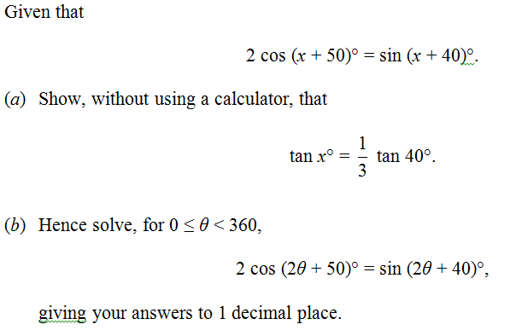
“That” question
Edexcel June 2013 Q3
a
?
‘Expanding’ both sides:
$$2\cos{x}\cos{50}−2\sin{x}\sin{50} \\ =\sin{x}\cos{40}+\cos{x}\sin{40}$$
Since thing to prove only has 40 in it, use $\cos{50}=\sin{40}$ and $\sin{50}=\cos{40 }.$
$$2\cos{x}\sin{40}−2\sin{x}\cos{40 } \\ =\sin{x}\cos{40}+\cos{x}\sin{40}$$
As per usual, when we want tans, divide by $\cos{x}\cos{40}$:
$$2\tan{40}−2\tan{x}=\tan{x}+\tan{40} \\ \tan{40}=3\tan{x} \\ \frac{1}{3}\tan{40}=\tan{x}$$
b
As always with ‘hence’ questions like this, compare original statement and statement we’re solving. $x=2θ$Thus:
$$\tan{2θ}=\frac{1}{3}\tan{40} \\ 2θ=15.63°, 195.63°, 375.63°, 555.63° \\ θ=7.8°, 97.8°, 187.8°, 277.8°$$
?

Slide 32
Double Angle Formulae
!
You will probably never use this 1st form.
$$\sin\left(2A\right)≡2\sin{A}\cos{A} \\ \cos\left(2A\right)≡\cos^{2}{A}−\sin^{2}{A}$$ $≡2\cos^{2}{A}−1$ $$≡1−2\sin^{2}{A}$$ $$\tan\left(2A\right)=\frac{2\tan{A}}{1−\tan^{2}{A}}$$
Bro Tip: The way I remember what way round these go is that the cos on the RHS is ‘attracted’ to the cos on the LHS, whereas the sin is pushed away.
These are all easily derivable by just setting $A=B$ in the compound angle formulae.

Slide 33
Exercises
Rewrite the following as a single trigonometric function:
$$2\sin{40\cos{40}=\sin{80}} 2\sin{5x}\cos{5x}=\sin{10x} \\ \sin{x}\cos{x}=\frac{1}{2}\sin{2x} 4\cos^{2}{θ}−2=2\cos{2θ}$$
?
?
?
?
Exercise 7B
Q1a, c, e, g
Q2a, d
Q3a, c, e, g, i

Slide 34
Examples
More prove-y questions:
Bro Tip: Whenever you see a mixture of $2θ$ and $θ$, your instinct should be to use the double angle formulae so everything is in terms of just $θ$.
Prove that $\tan{2θ}≡\frac{2}{\cot{θ}−\tan{θ}}$
$$\tan{2θ}≡\frac{2\tan{θ}}{1−\tan^{2}{θ}}≡\frac{2}{\frac{1}{\tan{θ}}−\tan{θ}} \\ ≡\frac{2}{\cot{θ}−\tan{θ}}$$
More solve-y questions:
?
Solve $3\cos{2x}−\cos{x}+2=0$ for $0≤x<360$
?
Clearly use $\cos{2x}=2\cos^{2}{−1}$ so that everything is in terms of cos.
$$3\left(2\cos^{2}{x}−1\right)−\cos{x}+2=0 \\ 6\cos^{2}{x}−3−\cos{x}+2=0 \\ 6\cos^{2}{x}−\cos{x}−1=0 \\ \left(3\cos{x}+1\right)\left(2\cos{x}−1\right)=0 \\ \cos{x}=−\frac{1}{3} or\cos{x}=\frac{1}{2} \\ x=60°, 109.5°, 250.5°, 300°$$
Prove that $\frac{1−\cos{2θ}}{\sin{2θ}}≡\tan{θ}$
?
$$\frac{1−\left(1−2\sin^{2}{θ}\right)}{2\sin{θ}\cos{θ}}≡\frac{2\sin^{2}{θ}}{2\sin{θ}\cos{θ}}≡\tan{θ}$$
Bro Tip: Use the variant of $\cos{2θ}$ that simplifies your expression the most.

Slide 35
More Examples
Q
By noting that $3A=2A+A$, determine:
$\sin{3A}$in terms of $\sin{A}$
$$\sin\left(2A+A\right) \\ =\sin{2A}\cos{A}+\cos{2A}\sin{A} \\ =2\sin{A}\cos{A}\cos{A}+\left(1−2\sin^{2}{A}\right)\sin{A} \\ =2\sin{A}\left(1−\sin^{2}{A}\right)+\sin{A}−2\sin^{3}{A} \\ =2\sin{A}−2\sin^{3}{A}+\sin{A}−2\sin^{3}{A} \\ =3\sin{A}−4\sin^{3}{A}$$
$\cos{3A}$ in terms of $\cos{A}$
$$=4\cos^{3}{A}−3\cos{A}$$
?
Q
?
Q
Given that $x=3\sin{θ}$ and $y=3−4\cos{2θ}$, express $y$ in terms of $x$.
$$y=3−4\left(1−2\sin^{2}{θ}\right) \\ =3−4\left(1−2{\left(\frac{x}{3}\right)}^{2}\right) \\ =3−4+\frac{8x^{2}}{9} \\ =\frac{8}{9}x^{2}−1$$
?

Slide 36
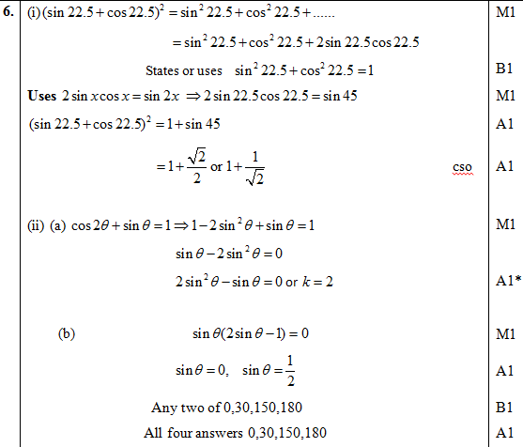
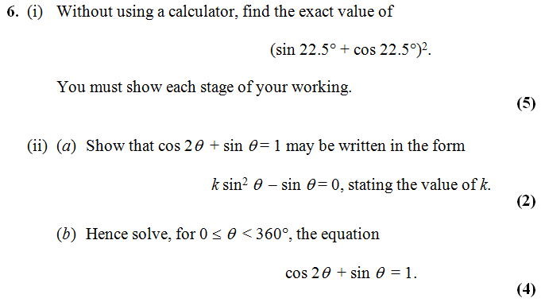
Exercise 7C
Q1a, c, e, g, i
Q3a, c, e, g, i, k, m
Q4, Q10, Q13
Edexcel Jan 2013 Q6
?

Slide 37
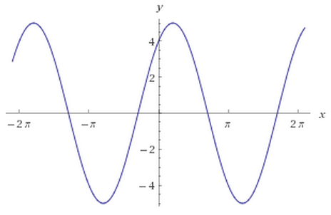
$$a\sin{θ}+b\sin{θ}$$
Here’s a sketch of $y=3\sin{x}+4\cos{x}$.
What do you notice?
?
It’s a sin graph that seems to be translated on the $x$-axis and stretched on the $y$ axis. This suggests we can represent it as $R sin⁡(x+α)$

Slide 38
$$a\sin{θ}+b\sin{θ}$$
Q
Put $3\sin{x}+4\cos{x}$ in the form $R\sin\left(x+α\right)$ giving $α$ in degrees to 1dp.
STEP 1: Expanding:
$$R\sin\left(x+α\right)=R\sin{x}\cos{α}+R\cos{x}\sin{α}$$
STEP 2: Comparing coefficients:
$$R\cos{α}=3 R\sin{α}=4$$
STEP 3: Using the fact that $R^{2}\sin^{2}{α}+R^{2}\cos^{2}{α}=R^{2}$:
$$R=\sqrt{3^{2}+4^{2}}=5$$
STEP 4: Using the fact that $\frac{R\sin{α}}{R\cos{α}}=\tan{α}$:
$$\tan{α}=\frac{4}{3}$$
$$α=53.1°$$
STEP 5: Put values back into original expression.
$$3\sin{x}+4\cos{x}≡5\sin\left(x+53.1°\right)$$
Bro Tip: I recommend you follow this procedure every time – I’ve tutored students who’ve been taught a ‘shortcut’ (usually skipping Step 1), and they more often than not make a mistake.
?
?
?
?
?

Slide 39
Test Your Understanding
Q
Put $\sin{x}+\cos{x}$ in the form $R\sin\left(x+α\right)$ giving $α$ in terms of $π$.
?
$$R\sin\left(x+α\right)≡R\sin{x}\cos{α}+R\cos{x}\sin{α}$$
$$R\cos{α}=1 R\sin{α}=1$$
$$R=\sqrt{1^{2}+1^{2}}=\sqrt{2}$$
$$\tan{α}=1$$
$$α=\frac{π}{4}$$
$$\sin{x}+\cos{x}≡\sqrt{2}\sin\left(x+\frac{π}{4}\right)$$
Q
Put $\sin{x}−\sqrt{3}\cos{x}$ in the form $R\sin\left(x−α\right)$ giving $α$ in terms of $π$.
?
$$R\sin\left(x+α\right)≡R\sin{x}\cos{α}−R\cos{x}\sin{α}$$
$$R\cos{α}=1 R\sin{α}=\sqrt{3} \\ R=2$$
$$\tan{α}=\sqrt{3} so α=\frac{π}{3}$$
$$\sin{x}+\cos{x}≡2\sin\left(x−\frac{π}{3}\right)$$

Slide 40
Further Examples
Q
Put $2\cos{θ}+5\sin{θ}$ in the form $R\cos\left(θ−α\right)$ where $0<α<90°$
Hence solve, for $0<θ<360$, the equation $2\cos{θ}+5\sin{θ}=3$
$$2\cos{θ}+5\sin{θ}≡\sqrt{29}\cos\left(θ−68.2°\right)$$ Therefore:
$$\sqrt{29}\cos\left(θ−68.2°\right)=3 \\ \cos\left(θ−68.2°\right)=\frac{3}{\sqrt{29}} \\ θ−68.2°=−56.1…°, 56.1…° \\ θ=12.1°, 124.3°$$
Bro Tip: This is an exam favourite!
Q
(Without using calculus), find the maximum value of $12\cos{θ}+5\sin{θ}$, and give the smallest positive value of $θ$ at which it arises.
?
Use either $R\sin{(θ+α)}$ or $R\cos{(θ−α})$before that way the + sign in the middle matches up.
$$≡13\cos\left(θ−22.6°\right)$$
Cos is at most 1,thus the expression has value at most 13.
This occurs when $θ−22.6=0$ (as $\cos{0}=1$) thus $θ=22.6$

Slide 41
Quickfire Maxima
What is the maximum value of the expression and determine the smallest positive value of $θ$ (in degrees) at which it occurs.
Expression | Maximum | (Smallest) $θ$ at max
$$20\sin{θ}$$ | $$20$$ | $$90°$$
$$5−10\sin{θ}$$ | $$15$$ | $$270°$$
$$3\cos\left(θ+20°\right)$$ | $$3$$ | $$340°$$
$$\frac{2}{10+3\sin\left(θ−30\right)}$$ | $$\frac{2}{7}$$ | $$300°$$
?
?
?
?
?
?
?
?

Slide 42
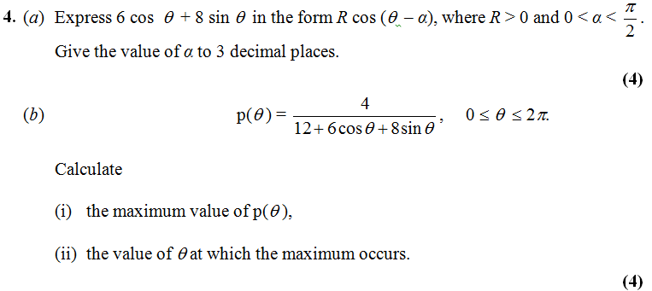
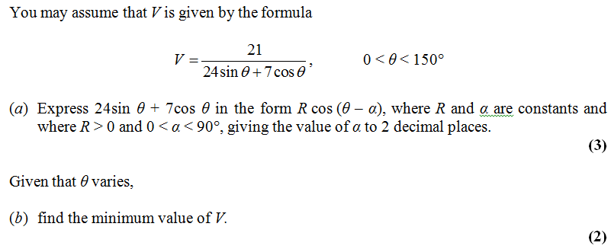
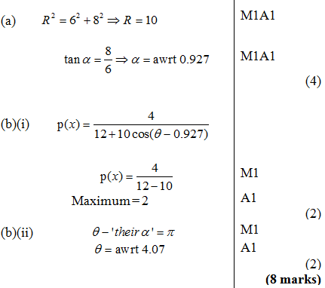
Exercise 7D
Q6, Q8, Q10, Q12, Q15
Jane 2013 Q4
Part of June 2013 Q8
?
?

Slide 43
‘Factor Formulae’
You already know how to deal with the following:
$$\sin{2x}+2\cos{2x}$$
i.e. a mix of sin and cos where the input of each trig function is the same.
?
Use $Rsin\left(2x+α\right)=…$
which leads to $\sqrt{5}\sin\left(2x+1.107\right)$
?
$$2\sin{4x}\cos{4x}$$
i.e. a mix of sin and cos where the input of each trig function is the same.
Use double-angle formulae backwards:
$$\sin{8x}=2\sin{4x}\cos{4x}$$
But what about…
$$\sin{x}+\sin{2x}$$
i.e. same trig function but where each input is different.
$$2\sin{x}\cos{3x}$$
$$2\sin{3x\sin{5x}}$$
i.e. product of trig functions (either the same or different) but again where inputs may be different.

Slide 44
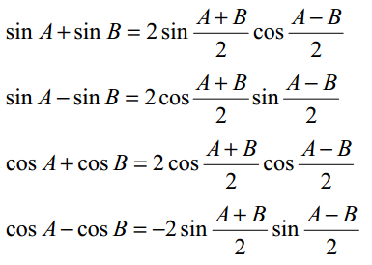
‘Factor Formulae’
These are all given in the formula booklet. It’s just a case of knowing how to use them, both forwards and backwards.
Examples:
Solve $\sin{4θ}−\sin{3θ}=0 0≤θ≤π$
$$2 cos\left(\frac{7θ}{2}\right)sin\left(\frac{θ}{2}\right)=0$$
If $0≤θ≤π$ then $0≤\frac{7θ}{2}≤\frac{7π}{2}$ and $0≤\frac{θ}{2}≤\frac{π}{2}$
If $cos\left(\frac{7θ}{2}\right)=0$,
$$\frac{7θ}{2}=\frac{π}{2},\frac{3π}{2},\frac{5π}{2},\frac{7π}{2} \\ θ=\frac{π}{7},\frac{3π}{7},\frac{5π}{7}, π$$
If $sin\left(\frac{θ}{2}\right)=0$,
$$\frac{θ}{2}=0 ∴θ=0$$
?
Show that $\sin{105°}−\sin{15°}=\frac{1}{\sqrt{2}}$
Notice that both the sum and the difference of 105 and 15 are ‘nice’ values from a trig perspective! Letting $A=105$ and $B=15$:
$$\sin{105°}−\sin{15°}=2\cos{60}\sin{45} \\ =2×\frac{1}{2}×\frac{1}{\sqrt{2}}=1/\sqrt{2}$$
?

Slide 45
Proof
Note that:
$$\sin\left(P+Q\right)≡\sin{P}\cos{Q}+\cos{P}\sin{Q} \\ \sin\left(P−Q\right)≡\sin{P}\cos{Q}−\cos{P}\sin{Q}$$
When we add these together, we convenient get:
$$\sin\left(P+Q\right)+\sin\left(P−Q\right)≡2\sin{P}\cos{Q}$$
If we let $P=\frac{A+B}{2}, Q=\frac{A−B}{2}$:
$$P+Q=A \\ P−Q=B$$
Thus:
$$\sin{A}+\sin{B}≡2\sin\left(\frac{A+B}{2}\right)\cos\left(\frac{A−B}{2}\right)$$
?
?
?
?
?

Slide 46
Further Example
Prove that $\frac{\sin\left(x+2y\right)+\sin\left(x+y\right)+\sin{x}}{\cos\left(x+2y\right)+\cos\left(x+y\right)+\cos{x}}≡\tan\left(x+y\right)$
Hint: combine the first and third term in the numerator and in the denominator (why?).
?
$$\sin\left(x+2y\right)+\sin{x}≡2\sin\left(x+y\right)\cos{y} \\ \cos\left(x+2y\right)+\cos{x}≡2\cos\left(x+y\right)\cos{y}$$
Therefore:
$$\frac{\sin\left(x+2y\right)+\sin\left(x+y\right)+\sin{x}}{\cos\left(x+2y\right)+\cos\left(x+y\right)+\cos{x}}≡\frac{2\sin\left(x+y\right)\cos{y}+\sin\left(x+y\right)}{2\cos\left(x+y\right)\cos{y}+\cos\left(x+y\right)} \\ ≡\frac{\sin\left(x+y\right)\left(2\cos{y}+1\right)}{\cos\left(x+y\right)\left(2\cos{y}+1\right)} \\ ≡\frac{\sin\left(x+y\right)}{\cos\left(x+y\right)} \\ ≡\tan\left(x+y\right)$$
?
?
?
?
?

Slide 47
Exercise 7E

