Slide 1
GCSE: Constructions & Loci
Dr J Frost (jfrost@tiffin.kingston.sch.uk)
Last modified: 28th December 2014

Slide 2
Everything in the GCSE specification
Construct triangles including an equilateral triangle
Construct the perpendicular bisector of a given line
Construct the perpendicular from a point to a line
Construct the perpendicular from a point on a line
Construct the bisector of a given angle
Construct angles of 60º, 90º , 30º, 45º
Construct a regular hexagon inside a circle
Construct: -a region bounded by a circle and an intersecting line - a given distance from a point and a given distance from a line - equal distances from 2 points or 2 line segments - regions which may be defined by ‘nearer to’ or ‘greater than’

Slide 3
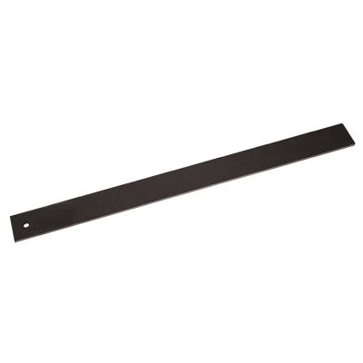
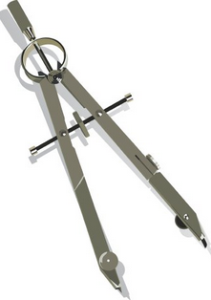
Constructions
To ‘construct’ something in the strictest sense means to draw it using only two things:
?
NO! IT IS NOT A RULER YOU EEJIT
?
Straight Edge
Compass

Slide 4
Skill #1: Perpendicular Bisector
Draw any two points, label them A and B, and find their perpendicular bisector.
STEP 2: Using the same distance on your compass, draw another arc, ensuring you include the points of intersection with the other arc.
A
B
STEP 1: Put your compass on A and set the distance so that it’s slightly more than halfway between A and B. Draw an arc.
STEP 3: Draw a line between the two points of intersection.

Slide 5
Common Losses of Exam Marks
A
A
B
B
Le Problemo:
Arcs don’t overlap enough, so points of intersection to draw line through is not clear.
Le Problemo:
Locus is not long enough.
(Since it’s actually infinitely long, we want to draw it sufficiently long to suggest it’s infinite)
?
?

Slide 6
Skill #2: Constructing Polygons
a. Equilateral Triangle
Draw a line of suitable length (e.g. 7cm) in your books, leaving some space above.
Construct an equilateral triangle with base AB.
Click to Brosketch
Draw two arcs with the length AB, with centres A and B.
A
B

Slide 7
Skill #2: Constructing Polygons
b. Other Triangles
“Construct a triangle with lengths 7cm, 5cm and 4cm.”
(Note: this time you do obviously need a ‘ruler’!)
Click to Brosketch
5cm
4cm
A
B
7cm
(It’s easiest to start with longest length)

Slide 8
Skill #2: Constructing Polygons
c. Square
Click for Step 1
Click for Step 2
With the compass set to the length AB and compass on the point B, draw an arc and find the intersection with the line you previously drew.
Click for Step 3
Extend the line and centering the compass at B, mark two points the same distance from B. Draw their perpendicular bisector.
A
B

Slide 9
Skill #2: Constructing Polygons
c. Hexagon
Click for Step 1
Start by drawing a circle with radius 5cm.
A
B
Click for Step 2
Click for Step 3
Make a point A on the circle.
Using a radius of 5cm again, put the compass on A and create a point B on the circumference.

Slide 10
Constructing a Regular Pentagon
(No need to write this down!)

Slide 11
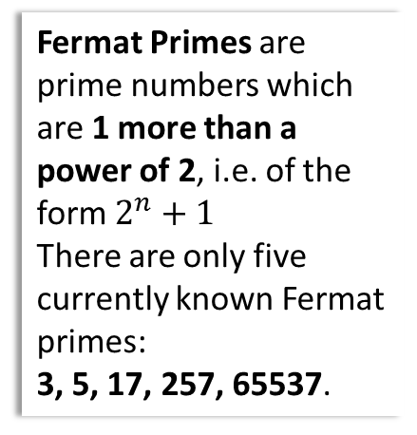
What about any n-sided regular polygon?
You may be wondering if it’s possible to ‘construct’ a regular polygon with ruler and compass of any number of sides $n$.
In 1801, a mathematician named Gauss proved that a $n$-gon is constructible using straight edge and compass if and only if $n$ is the product of a power of 2 and any number (including 0) of distinct Fermat primes.
This became known as the Gauss-Wantzel Theorem.
(Note that the power of 2 may be 0)
Q: List all the constructible regular polygons up to 20 sides.
Fermat Primes are prime numbers which are 1 more than a power of 2, i.e. of the form $2^{n}+1$
There are only five currently known Fermat primes:
3, 5, 17, 257, 65537.
3, 4, 5, 6, 8, 10, 12, 15, 16, 17, 20
?
Q: Given there are only 5 known Fermat primes, how many odd-sided constructable $n$-gons are there?
?
31. Each Fermat prime can be included in the product or not. That’s $2^{6}=32$ ways. But we want to exclude the one possibility where no Fermat primes are used.

Slide 12
Skill #3: Angular Bisector
Now draw two lines A and B that join at one end. Find the angular bisector of the two lines.
STEP 1: Use your compass the mark two points the same distance along each line.
A
STEP 2: Find the perpendicular bisector of the two points.
The line is known as the angle bisector because it splits the angle in half.
B

Slide 13
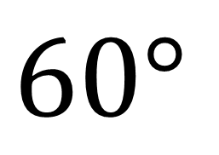
Skill #4: Constructing Angles
$$60°$$
Click to Brosketch
Some as constructing equilateral triangle – only difference is that third line is not wanted.
A
B

Slide 14
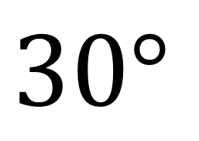
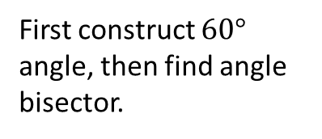
Skill #4: Constructing Angles
$$30°$$
Click to Brosketch
First construct $60°$ angle, then find angle bisector.
A
B

Slide 15
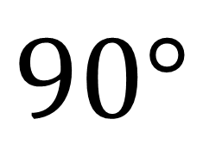
Skill #4: Constructing Angles
$$90°$$
Click to Brosketch
Same as constructing a square, except you won’t need other line or additional arcs.
You will be told what point to construct angle at (in this case A)
A
B

Slide 16
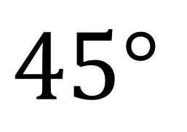
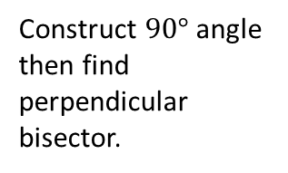
Skill #4: Constructing Angles
$$45°$$
Click to Brosketch
Construct $90°$ angle then find perpendicular bisector.
A
B

Slide 17
Skill #5: Construct the perpendicular from a point to a line
You know how to find the perpendicular bisector. But how do you ensure it goes through a particular point?
Click for Step 1
Click for Step 2
Find perpendicular bisector of these two points.
Centre compass on point and mark two points with the same distance on the line.

Slide 18
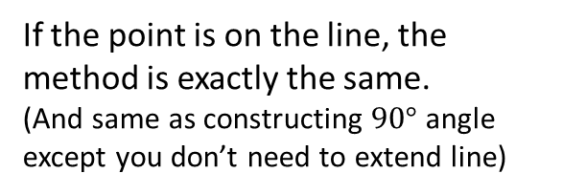
Skill #6: Construct the perpendicular from a point on a line
If the point is on the line, the method is exactly the same.
(And same as constructing $90°$ angle except you don’t need to extend line)
Click for Step 1
Click for Step 2
Find perpendicular bisector of these two points.
Centre compass on point and mark two points with the same distance on the line.

Slide 19
Overview
Construct triangles including an equilateral triangle
Construct the perpendicular bisector of a given line
Construct the perpendicular from a point to a line
Construct the perpendicular from a point on a line
Construct the bisector of a given angle
Construct angles of 60º, 90º , 30º, 45º
Construct a regular hexagon inside a circle
Construct: -a region bounded by a circle and an intersecting line - a given distance from a point and a given distance from a line - equal distances from 2 points or 2 line segments - regions which may be defined by ‘nearer to’ or ‘greater than’
✓
✓
✓
✓
✓
✓
✓
‘Loci’ stuff we’re doing next lesson.

Slide 20
Loci
! A locus of points is a set of points satisfying a certain condition.
We can use our constructions from last lesson to find the loci satisfying certain conditions…
Loci involving:
Thing A
Thing B
Interpretation
Resulting Locus
Point
-
A given distance from point A
?
A
Line
-
A given distance from line A
?
A
Point
Point
Equidistant from 2 points or given distance from each point.
?
Perpendicular bisector
A
B
Line
Line
Equidistant from 2 lines
?
A
Angle bisector
B
Point
Line
Equidistant from point A and line B
?
A
Parabola
B

Slide 21
Regions satisfying descriptions
Loci can also be regions satisfying certain descriptions.
Click to Broshade
Moo!
3m
3m
Click to Broshade
A goat is attached to a post, by a rope of length 3m. Shade the locus representing the points the goat can reach.
A goat is now attached to a metal bar, by a rope of length 3m. The rope is attached to the bar by a ring, which is allowed to move freely along the bar. Shade the locus representing the points the goat can reach.
A
Shade the region consisting of points which are closer to line A than to line B.
Common schoolboy error: Thinking the locus will be oval in shape.
Click to Broshade
As always, you MUST show construction lines or you will be given no credit.
B

Slide 22
Examples
Q
I’m at most 2m away from the walls of a building. Mark this region with $R$.
Copy the diagram (to scale) and draw the locus. Ensure you use a compass.
R
Scale: 1m : 1cm
2m
2m
Circular corners.
10m
Straight corners.
2m
10m

Slide 23
Examples
Q
I’m 2m away from the walls of a building.
Copy the diagram (to scale) and draw the locus. Ensure you use a compass.
Scale: 1m : 1cm
2m
6m
10m
6m
Click to Broshade
10m

Slide 24
Examples
Q
Scale: 1m : 1cm
My goat is attached to a fixed point A on a square building, of
5m x 5m, by a piece of rope 10m in length. Both the goat and rope are fire resistant. What region can he reach?
R
A
10m
Bonus question:
What is the area of this region, is in terms of π?
87.5 π
5m
Click to Broshade
?

Slide 25
Exercises on worksheet in front of you
(Answers on next slides)
Killer questions if you finish…
For the following questions, calculate the area of the locus of points, in terms of the given variables (and $π$ where appropriate). Assume that you could be inside or outside the shape unless otherwise specified.
$x$ metres away from the edges of a square of length $l$.
$x$ metres away from the edges of a rectangle of sides $w$ and $h$ (assume $x<\frac{h}{2}$ and $x<\frac{w}{2}$).
$x$ metres away from the edges of an equilateral triangle of side length $y$.
Inside a square ABCD of side $x$ metres, being at least $x$ metres from A, and closer to BC than to CD.
Being inside an equilateral triangle of side $2x$, and at least $x$ away from each of the vertices.
Being attached to one corner on the outside of $x×x$ square building (which you can’t go inside), by a rope of length $2x$.
At most $x$ metres away from an L-shaped building with two longer of longer sides $2x$ and four shorter sides of $x$ metres.
Being attached to one corner on the outside of $w×h$ square building (which you can’t go inside), by a rope of length $x$ (where $x<w+h$). You may wish to distinguish between the cases when $x<w$ and/or $x<h$ and otherwise.
N

Slide 26
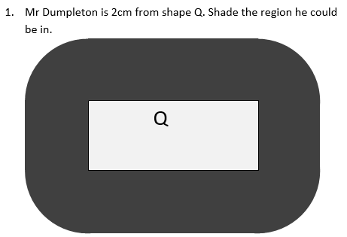
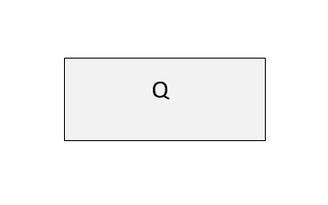
Answers

Slide 27
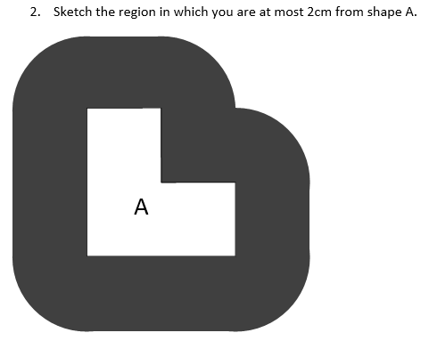
Answers

Slide 28
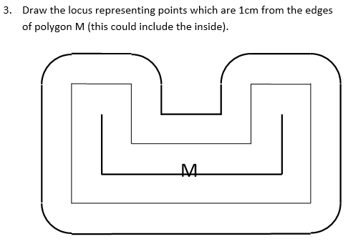
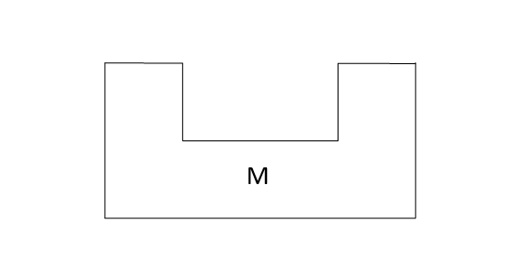
Answers

Slide 29
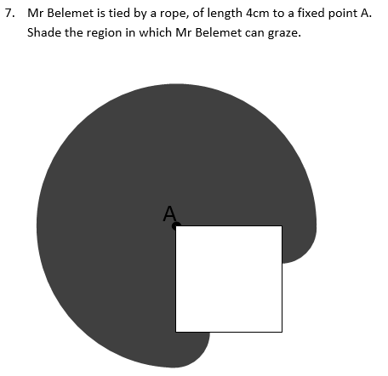
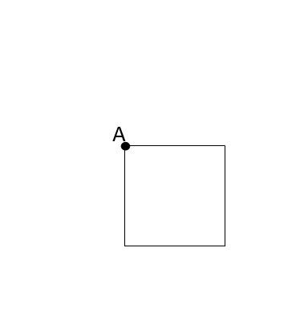
Answers

Slide 30
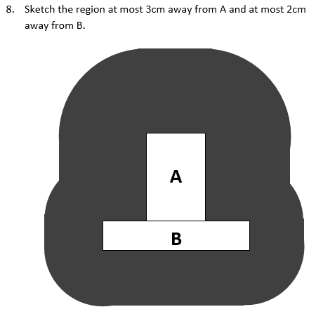
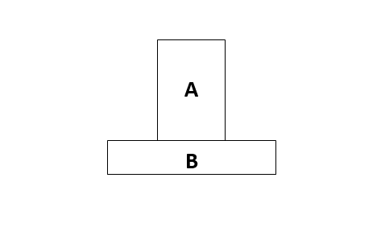
Answers
Bro Tip: Do regions separately for A and B and then identify overlap.

Slide 31
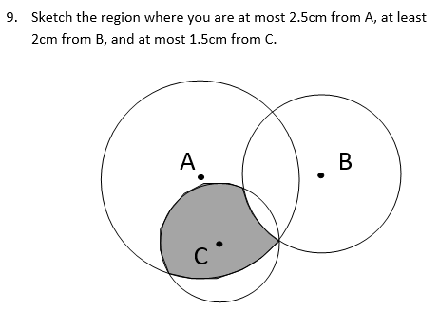
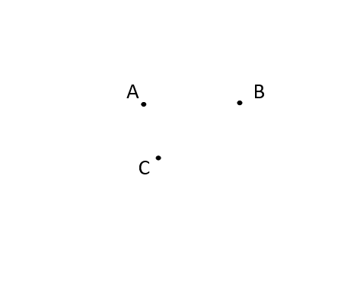
Answers

Slide 32
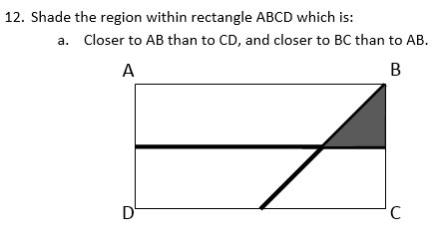
Answers

Slide 33
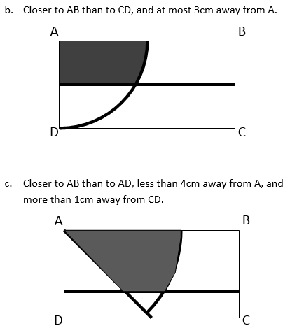
Answers

Slide 34
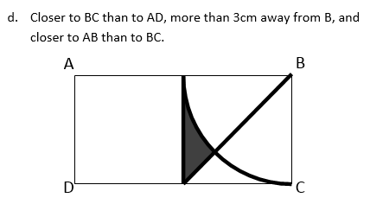
Answers

Slide 35


N Answers
N For the following questions, calculate the area of the locus, in terms of the given variables (and $π$ where appropriate). Assume that you could be inside or outside the shape unless otherwise specified.
$x$ metres away from the edges of a square of length $l$. 4 exterior rectangles: $4xl$ 4 quarter circles forming 1 full circle: $πx^{2}$ 4 interior rectangles: $4xl$ Total overlap on interior rectangles: $4x^{2}$ Total: $8xl+πx^{2}−4x^{2}$
$x$ metres away from the edges of a rectangle of sides $w$ and $h$. Using the same approach as above, Area: $4xw+4xl+πx^{2}−4x^{2}$
$x$ metres away from the edges of an equilateral triangle of side length $y$. 3 exterior rectangles: $3xy$ 3 sixth circles which form a semicircle: $\frac{1}{2}πx^{2}$ 3 interior rectangles (without overlap): $3x\left(y−2\sqrt{3}x\right)$ 6 interior corner right-angled triangles: $3\sqrt{3}x^{2}$ Total: $\frac{1}{2}πx^{2}+6xy−3\sqrt{3}x^{2}$
Inside a square ABCD of side $x$ metres, being at least $x$ metres from A, and closer to BC than to CD. First calculate area of square minus area of quarter circle: $x^{2}−\frac{1}{4}πx^{2}$Half it: $\frac{1}{8}x^{2}\left(8−π\right)$
Being inside an equilateral triangle of side $2x$, and at least $x$ away from each of the vertices. Area of entire triangle: $\sqrt{3}x^{2}$ Area of 3 sixth-circles forming semicircle: $\frac{1}{2}πx^{2}$ Total: $\frac{1}{2}x^{2}\left(2\sqrt{3}−π\right)$
Being attached to one corner on the outside of $x×x$ square building (which you can’t go inside), by a rope of length $2x$. $\frac{3}{4}$ of a circle with radius $2x$: $3πx^{2}$ Two quarter circles of radius $x$ forming a semicircle: $\frac{1}{2}πx^{2}$ Total: $\frac{7}{2}πx^{2}$
At most $x$ metres away from an L-shaped building with two longer of longer sides $2x$ and four shorter sides of $x$ metres. Five quarter-circles of radius $x$: $\frac{5}{4}πx^{2}$ Two rectangles: $4x^{2}$ Three squares: $3x^{2}$ Total: ${\frac{1}{4}x}^{2}\left(5π+28\right)$
Being attached to one corner on the outside of $w×h$ square building (which you can’t go inside), by a rope of length $x$ (where $x<w+h$). You may wish to distinguish between the cases when $x<w$ and/or $x<h$ and otherwise. Three quarters of a circle with radius $x$: $\frac{3}{4}πx^{2}$ If $x>w$, then we have an additional quarter circle with area $\frac{1}{4}π{\left(x−w\right)}^{2}$. Similarly, if $x>h$, we have an additional quarter circle with area $\frac{1}{4}π{\left(x−h\right)}^{2}$ If we let $\max\left(a,b\right)$ give the maximum of $a$ and $b$, then the total is: $\frac{3}{4}πx^{2}+\max\left(\frac{1}{4}π{\left(x−w\right)}^{2},0\right)+\max\left(\frac{1}{4}π{\left(x−h\right)}^{2},0\right)$ $Note that if were to allow x>w+h$, then things start to get very hairy!
?
?
?
?
?
?
?
?

