Slide 1
IGCSE Solving Equations
Dr J Frost (jfrost@tiffin.kingston.sch.uk)
Objectives: From the specification:
Last modified: 23rd August 2015

Slide 2
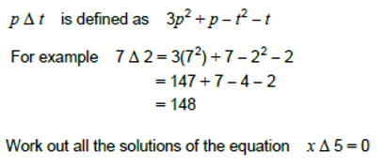
What makes this topic Further-mathsey?
There is no new material relative to the normal GCSE.
Here are types of questions that tend to come up:
Solving linear equations
Use of the quadratic formula
Equations involving algebraic fractions
Operators

Slide 3




RECAP :: Linear and other simple equations
June 2013 Paper 1
Set 1 Paper 2
?
?
$$33+\sqrt{x}=36 \\ \sqrt{x}=3 \\ x=9$$
$$9−2d=4−4d \\ 2d=−5 \\ d=−\frac{5}{2}$$
Bro Tip: Remember we ‘cross multiply’ if we just have a fraction on each side.
Set 4 Paper 2
Set 4 Paper 2
?
?
$$35+4x^{2}=36 \\ 4x^{2}=1 \\ x^{2}=\frac{1}{4} \\ x=±\frac{1}{2}$$
$$27=8x^{3} \\ \frac{27}{8}=x^{3} \\ x=\frac{3}{2}$$

Slide 4
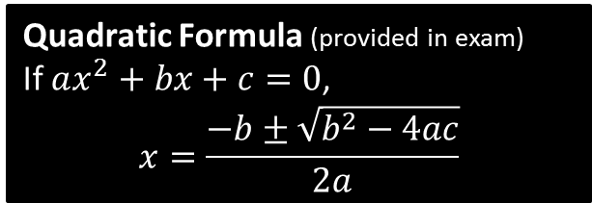
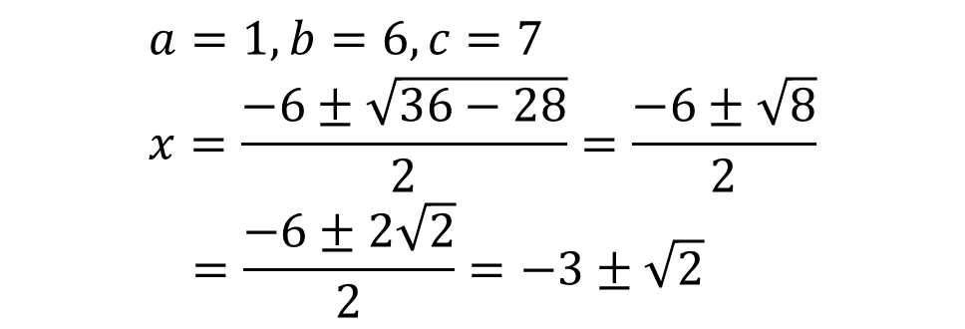
RECAP :: Use of the quadratic formula
?
$$a=1, b=6, c=7 \\ x=\frac{−6±\sqrt{36−28}}{2}=\frac{−6±\sqrt{8}}{2} \\ =\frac{−6±2\sqrt{2}}{2}=−3±\sqrt{2}$$
Quadratic Formula (provided in exam)
If $ax^{2}+bx+c=0$,
$$x=\frac{−b±\sqrt{b^{2}−4ac}}{2a}$$

Slide 5

RECAP :: Algebraic fractions in equations
First Step ?
$$\frac{4\left(x+3\right)+1\left(x−2\right)}{\left(x−2\right)\left(x+3\right)}=5$$
$$5x+10=5\left(x−2\right)\left(x+3\right) \\ 5x+10=5\left(x^{2}+x−6\right) \\ 5x+10=5x^{2}+5x−30 \\ 5x^{2}−40=0 \\ x^{2}=8 \\ x=±\sqrt{8}=±2\sqrt{2}$$
Simply combine any fractions into one.
?

Slide 6

Test Your Understanding
$$\frac{x}{2x−3}+\frac{4}{x+1}=1 \\ \frac{x^{2}+9x−12}{\left(2x−3\right)\left(x+1\right)}=1$$ $$x^{2}+9x−12=\left(2x−3\right)\left(x+1\right) \\ x$$ ddddsds
$$x^{2}+9x−12=2x^{2}−x−3 \\ x^{2}−10x+9=0 \\ \left(x−1\right)\left(x−9\right)=0 \\ x=1 or x=9$$
?

Slide 7
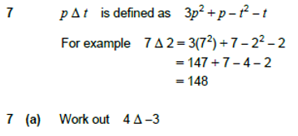
Defined Operators
An operator is simply a function used in a symbol like way.
For example $+\left(x,y\right)$ is a function which adds its two arguments $x$ and $y$, however we obviously write it as $x+y$ (+ is known as an ‘infix’ operator).
?
$$4Δ−3=3{\left(4\right)}^{2}+4−{\left(−3\right)}^{2}−\left(−3\right) \\ =48+4−9+3=46$$
$$xΔ5=3x^{2}+x−5^{2}−5=0 \\ 3x^{2}+x−30=0 \\ \left(3x+10\right)\left(x−3\right)=0 \\ x=−\frac{10}{3} or 3$$
?

Slide 8
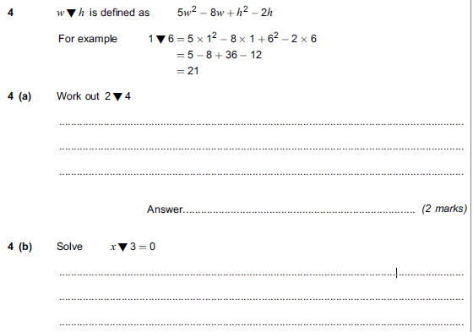
Test Your Understanding
Jan 2013 Paper 1
$$2∇4=5{\left(2\right)}^{2}−8\left(2\right)+4^{2}−2\left(4\right) \\ =20−16+16−8 \\ =12$$
?
$$x∇3=5x^{2}−8x+3^{2}−2\left(3\right) \\ 5x^{2}−8x+3=0 \\ \left(5x−3\right)\left(x−1\right)=0 x=\frac{3}{5}, 1$$
?

Slide 9
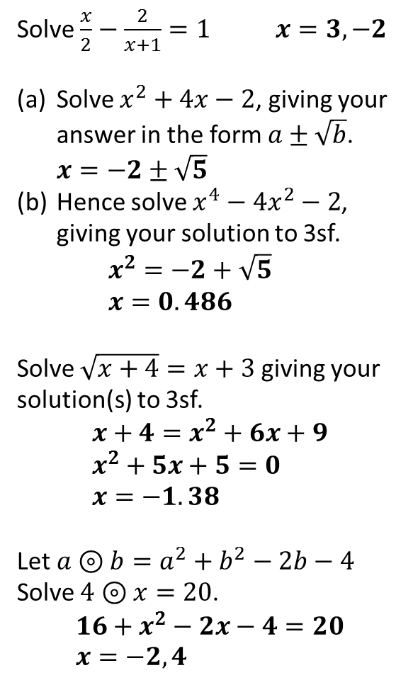
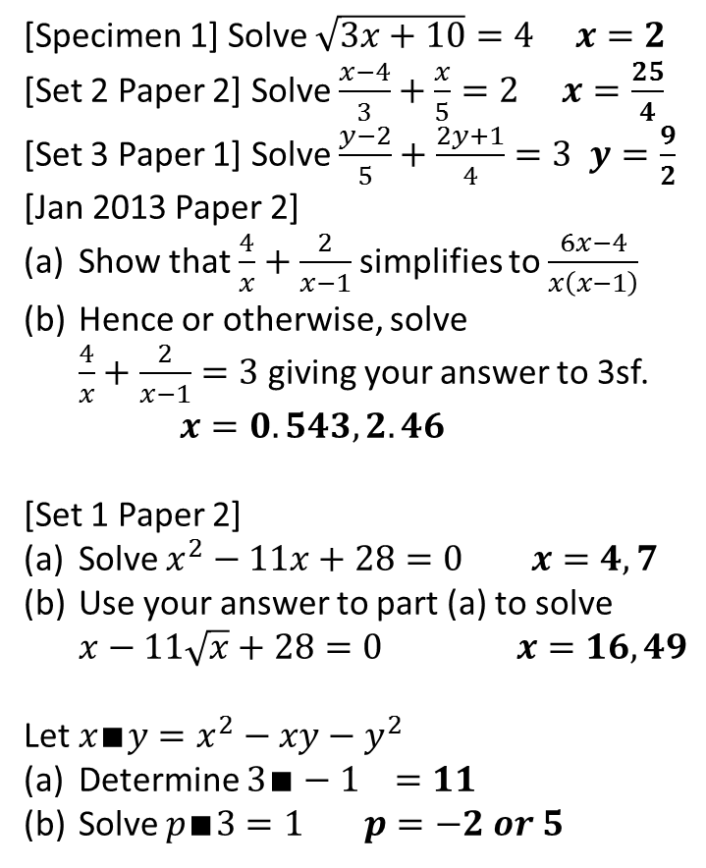
Exercises
?
?
1
[Specimen 1] Solve $\sqrt{3x+10}=4 x=2$
[Set 2 Paper 2] Solve $\frac{x−4}{3}+\frac{x}{5}=2$ $x=\frac{25}{4}$
[Set 3 Paper 1] Solve $\frac{y−2}{5}+\frac{2y+1}{4}=3$ $y=\frac{9}{2}$
[Jan 2013 Paper 2]
Show that $\frac{4}{x}+\frac{2}{x−1}$ simplifies to $\frac{6x−4}{x\left(x−1\right)}$
Hence or otherwise, solve $\frac{4}{x}+\frac{2}{x−1}=3$ giving your answer to 3sf. $x=0.543, 2.46$
[Set 1 Paper 2]
Solve $x^{2}−11x+28=0$ $x=4,7$
Use your answer to part (a) to solve $x−11\sqrt{x}+28=0$ $x=16,49$
Let $x∎y=x^{2}−xy−y^{2}$
Determine $3∎−1 =11$
Solve $p∎3=1$ $p=−2 or 5$
7
Solve $\frac{x}{2}−\frac{2}{x+1}=1 x=3, −2$
Solve $x^{2}+4x−2$, giving your answer in the form $a±\sqrt{b}$. $x=−2±\sqrt{5}$
Hence solve $x^{4}−4x^{2}−2$, giving your solution to 3sf. $x^{2}=−2+\sqrt{5}$ $x=0.486$
Solve $\sqrt{x+4}=x+3$ giving your solution(s) to 3sf.
$$x+4=x^{2}+6x+9 \\ x^{2}+5x+5=0 \\ x=−1.38$$
Let $a⊚b=a^{2}+b^{2}−2b−4$
Solve $4⊚x=20$.
$$16+x^{2}−2x−4=20 \\ x=−2, 4$$
2
?
3
?
8
4
?
?
?
5
?
9
?
?
6
?
10
?
?

