Slide 1
IGCSE Simultaneous Equations
Dr J Frost (jfrost@tiffin.kingston.sch.uk)
www.drfrostmaths.com
Objectives: The specification:
Last modified: 29th December 2015

Slide 2
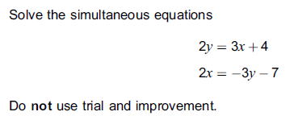
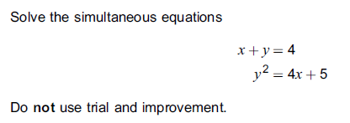
So what makes this topic Further-Maths-ey?
This is largely just the same as simultaneous equations, with either two linear equations, or one linear and one quadratic.
#1: The equations might not be in the usual $ax+by=c$ form.
How do you think you’ll deal with this?
Put them in form you’re used to!
$$3x−2y=−4 \\ 2x+3y=−7$$
?
#2: Normal GCSE questions, just slightly on the harder end.

Slide 3

Linear Simultaneous Equations not in usual form
If you wish to solve be elimination, it may be easiest to get your equations in the form $ax+by=c$ first as per GCSE.
Jan 2012 Paper 1 Q6
$$3x−2y=−4 \\ 2x+3y=−7$$
$$9x−6y=−12 \\ 4x+6y=−14$$
$$13x=−26 \\ x=−2 \\ y=−1$$
? Scale
? Eliminate

Slide 4
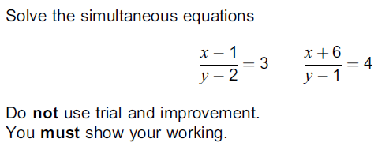
Another Example
Jan 2013 Paper 1 Q10
?
$$x−1=3y−6 \\ x+6=4y−4$$
We could always immediately subtract equations, being careful about sign:
$$7=y+2 \\ y=5$$
Sub into one of original equations to work out $x:$ $$x+6=20−4=16 \\ x=10$$

Slide 5
GCSE Recap :: Substitution
June 2012 Paper 2 Q19
Recap of Method:
Make $x$ or $y$ the subject in the linear equation.
Substitute into the quadratic expression.
Solve (ensuring you find the values of the other variable)
?
Making $x$ the subject is easier as we’ll avoid having to having to expand out a double bracket.
$$x=4−y$$
$$y^{2}=4\left(4−y\right)+5 \\ y^{2}=16−4y+5 \\ y^{2}+4y−21=0 \\ \left(y+7\right)\left(y−3\right)=0$$
$$y=−7 → x=4−−7=11 \\ y=3 → x=4−3=1$$

Slide 6


Check Your Understanding
Solve the following simultaneous equations:
$$x=1−2y \\ 2x=5y+29$$
$$x+2y=1 \\ 2x−5y=29$$
$$2x+4y=2 \\ 2x−5y=29 \\ 9y=−27 \\ y=−3 \\ x=7$$
?
Solve the following simultaneous equations:
$$x+2y=1 \\ x^{2}+y^{2}=10$$
$$x=1−2y \\ {\left(1−2y\right)}^{2}+y^{2}=10 \\ 1−4y+4y^{2}+y^{2}=10 \\ 5y^{2}−4y−9=0 \\ \left(5y−9\right)\left(y+1\right)=0 \\ y=−1 → x=3 \\ y=\frac{9}{5} → x=1−\frac{18}{5}=−\frac{13}{5}$$
?

Slide 7

Exercises
$$y=x−3 \\ 3x+2y=19$$
$$x=5, y=2$$
$$3x+2y=12 \\ 4x−y=5$$
$$x=2, y=3$$
$$5x=11−4y \\ 9−3y=2x$$
$$x=−\frac{3}{7}, y=\frac{23}{7}$$
$$\frac{x+1}{y+1}=−1 \frac{x−1}{y+3}=3$$
$$x=4, y=−2$$
$$x+y=3 \\ x^{2}+y^{2}=5 \\ x=1, y=2 \\ or x=2, y=1$$
$$y=x^{2} y−5x=6 \\ x=−1, y=1 \\ or x=6, y=36$$
$$y=x+2 \\ y^{2}=4x+5 \\ x=1, y=3 \\ or x=−1, y=1$$
$$x=2y \\ x^{2}−y^{2}+xy=20 \\ x=−4, y=−2 or x=4, y=2$$
Here are the equations of three lines.
$$y=\frac{1}{2}x+11 y=\frac{1}{3}x+14$$
$$y=2x−16$$
Do all three lines meet at a common point? Show how your decide.
Solving first two equations:
$$\frac{1}{2}x+11=\frac{1}{3}x+14 \\ \frac{1}{6}x=3 x=18 \\ y=20$$
Checking with third equation:
$$20=36−16=20$$
So lines do all meet.
1
7
?
?
2
7
?
?
3
8
?
4
?
5
?
?
6
?

